Slide 1
CONVOCALS

Slide 2
contents
The athero-express
Plaque analysis
Preprocessing
Classifications
Model choice
result

Slide 3
The athero-express
Long running biobank study (2001)

Slide 4
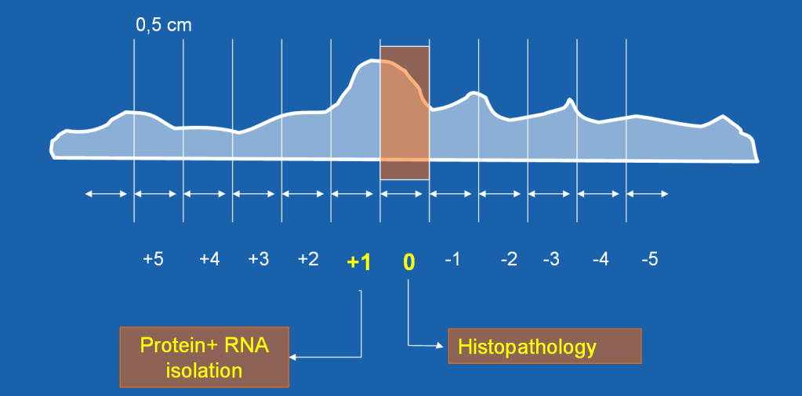

Slide 5
stainings
CD34 (endothelial cells)
CD66b (neutrophils)
CD68 (macrophages)
SMA (smooth muscle cells)
Collagen
Fibrin
EvG (elastin)
Glycophorin C (red blood cell)
HE

Slide 6
patients
Data of ±3500 patients
Not only images but also 3-year follow-up questionnaire data

Slide 7
Analysis of the plaques
Current approach (uses staining) pathology
Manual scoring of plaques
Subjective and error-prone
Differences between different observants

Slide 8
cellprofiler
More objective method
Rule based quantification of cells
Cells meeting stain criteria will be counted
Always the same
Pipelines have to be designed

Slide 9
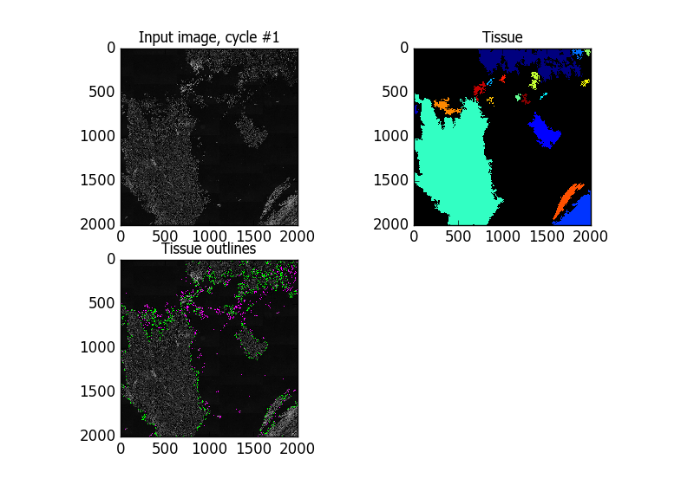

Cellprofiler – identifying tissue (sr stain)

Slide 10
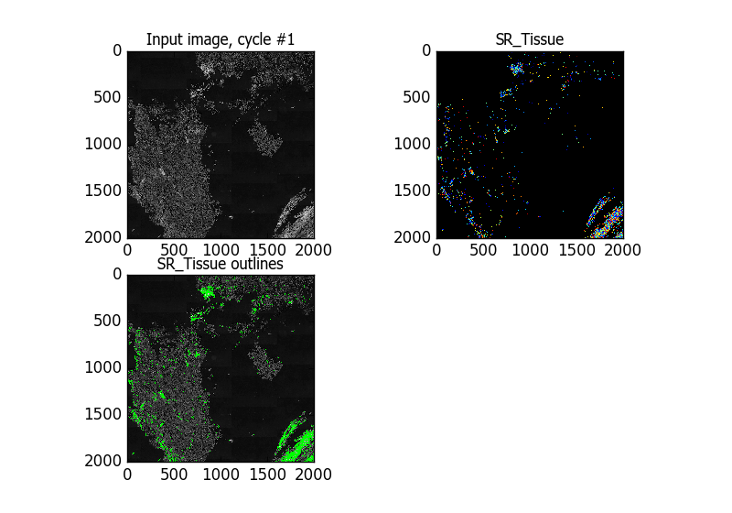
Cellprofiler – identifying staining

Slide 11
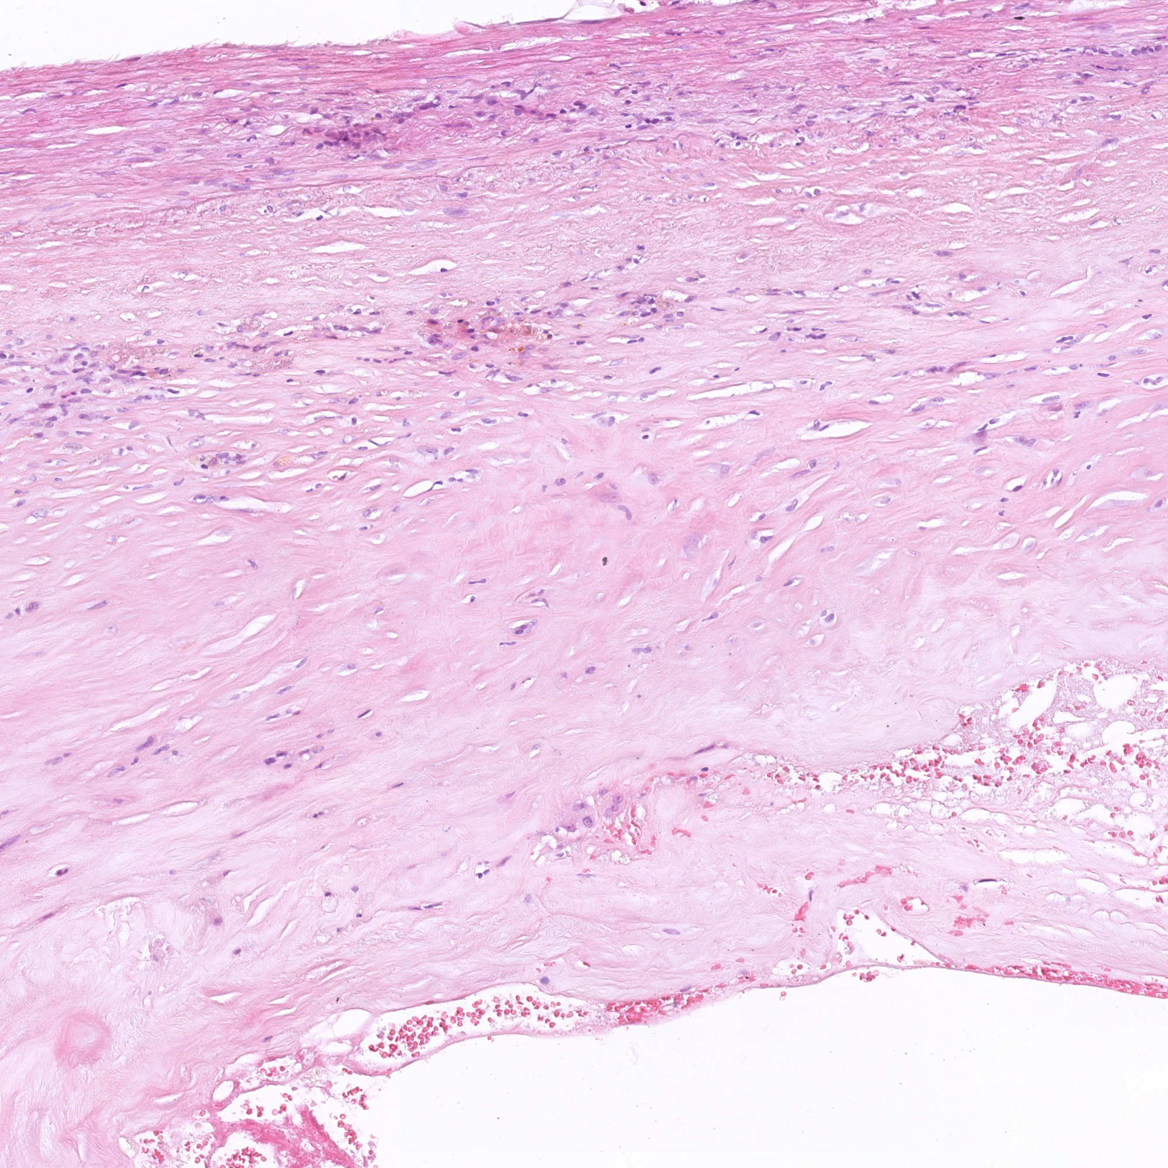
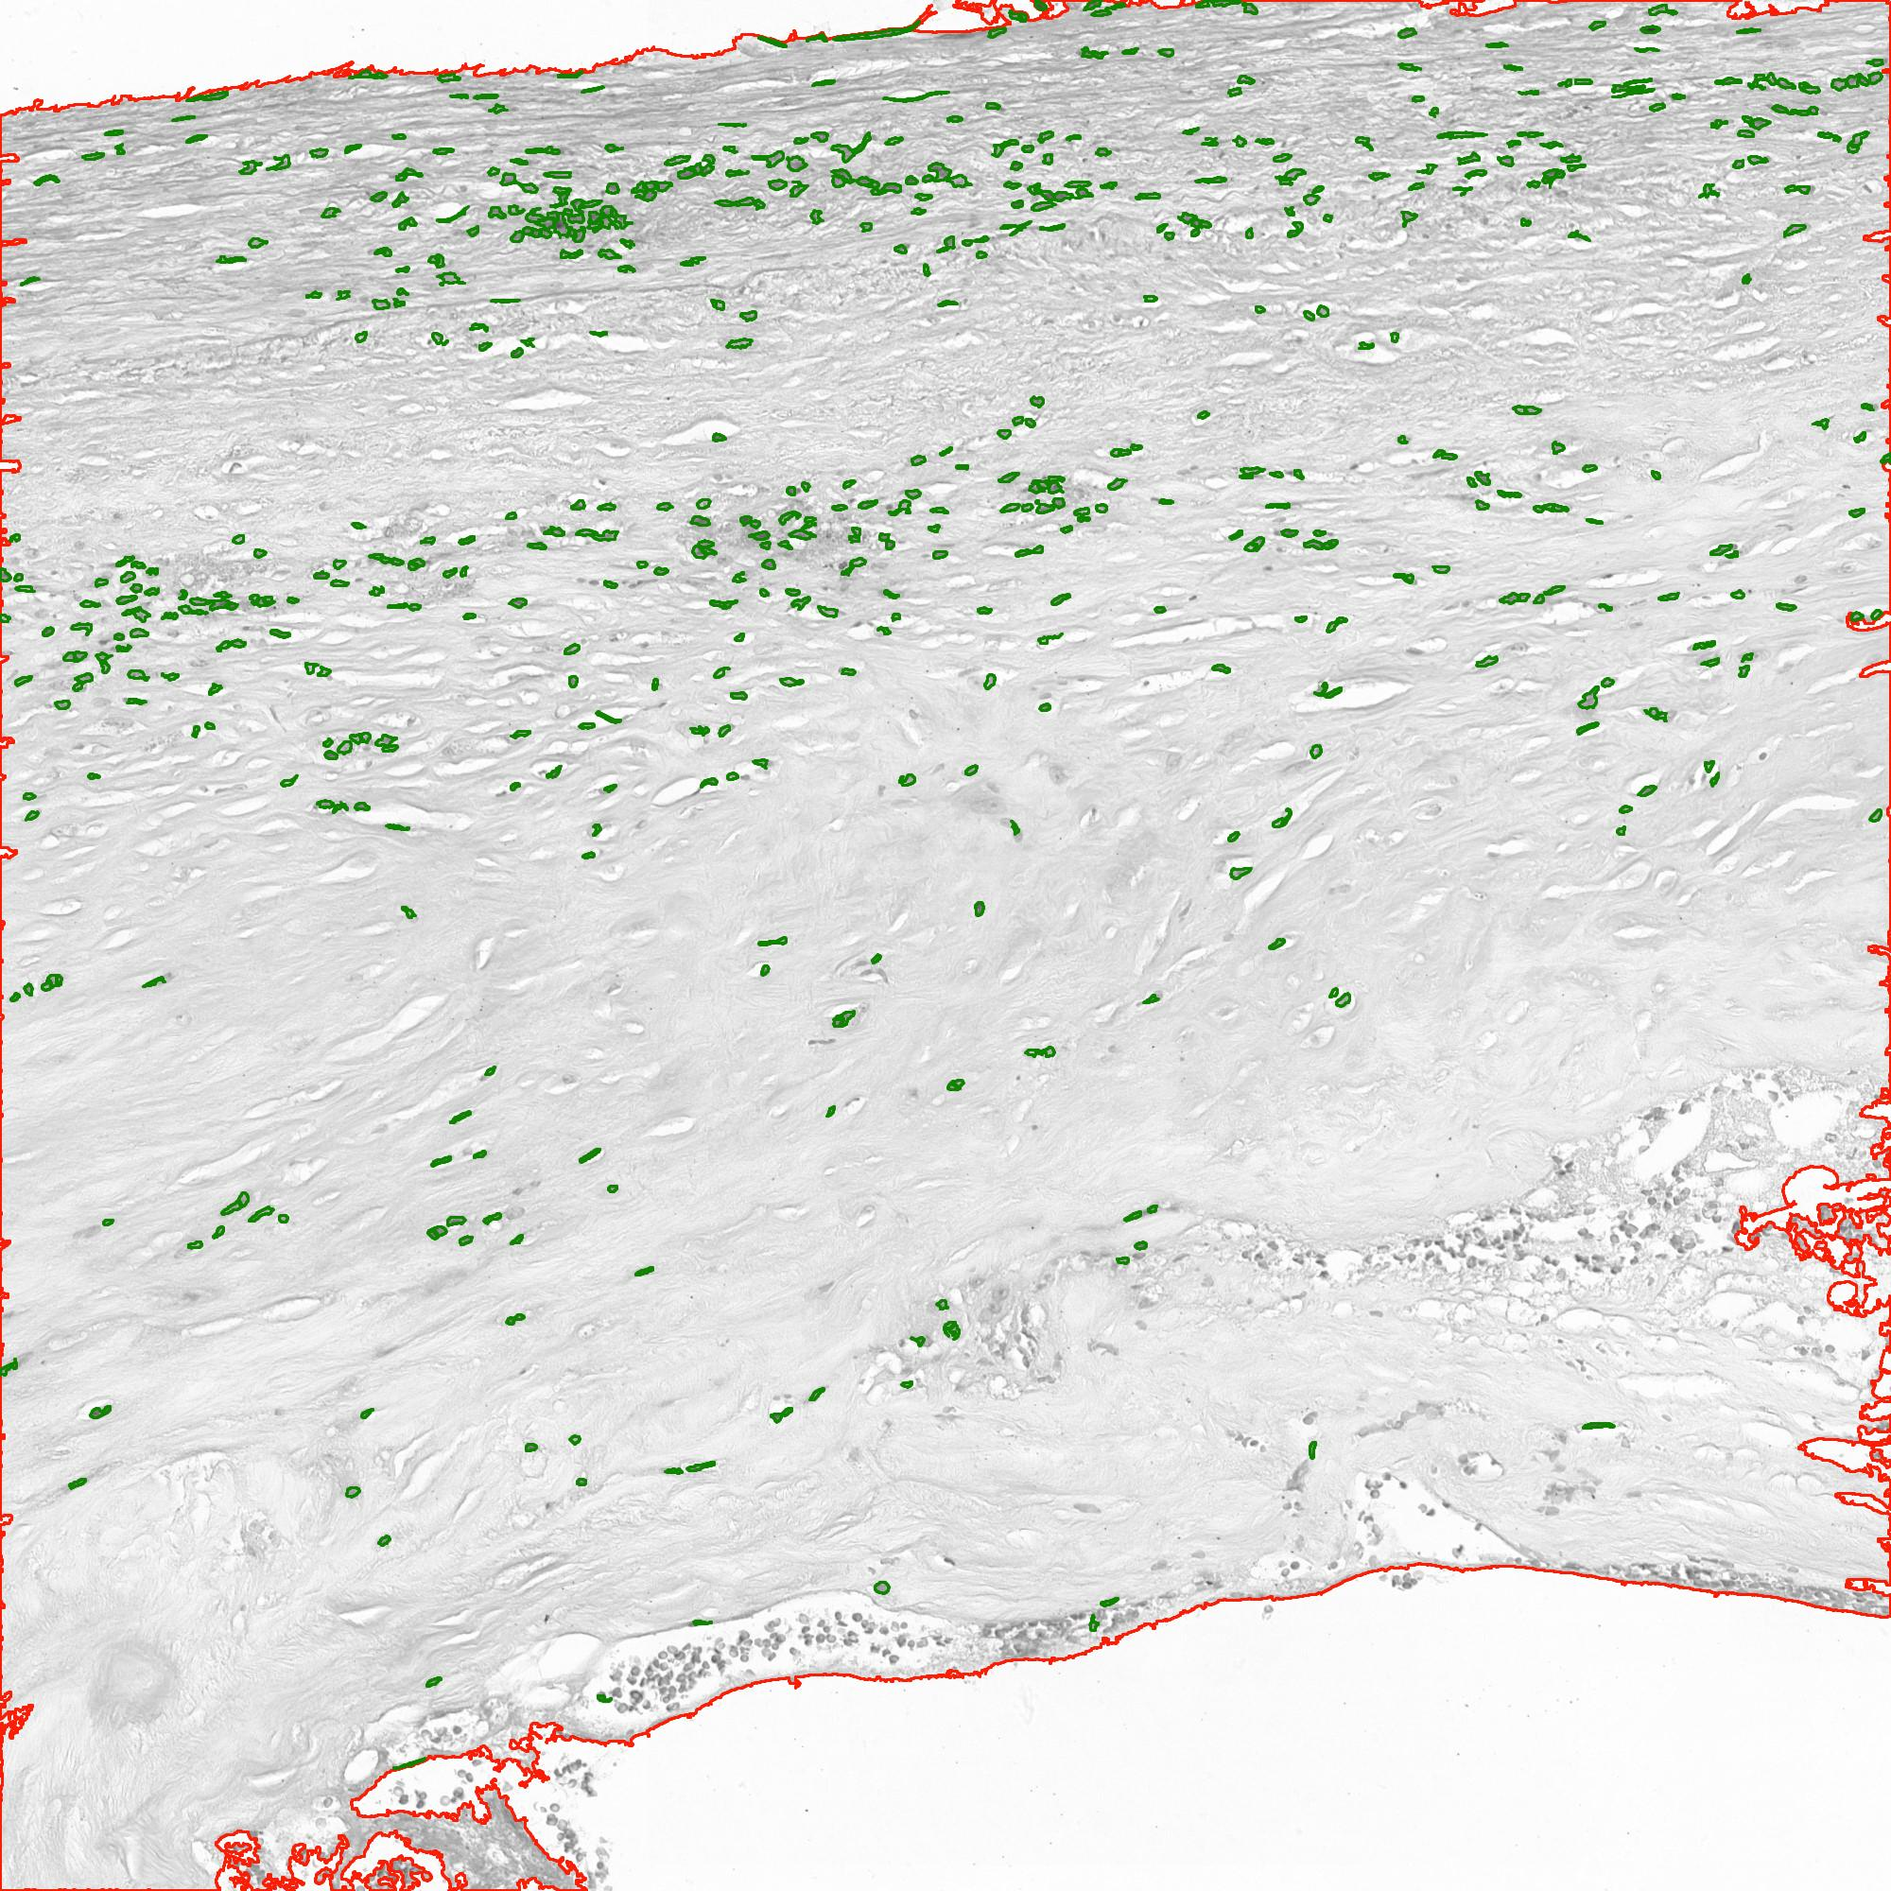
Cellprofiler – HE

Slide 12
Deep learning
Proposed method
Quantification, classification and prediction
Convolutional neural networks

Slide 13
preprocessing
Data is far from pure
Scratches or fractures on slide, air bubbles, dirt or even hair
Technical variance
2 different scanners
Big sizes

Slide 14
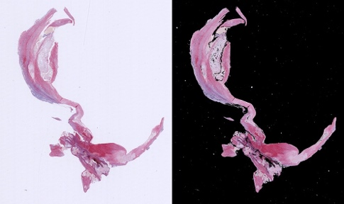
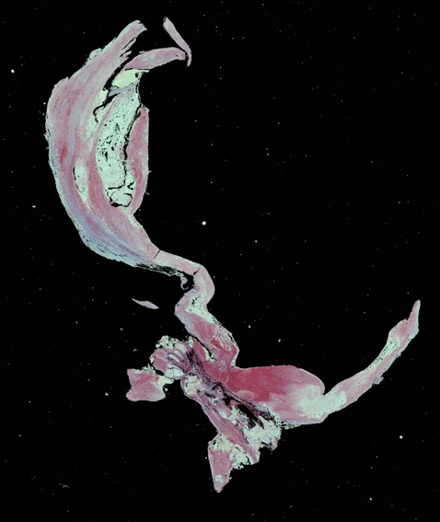
Masking the image

Slide 15
Countering overfitting
Image augmentation
K-fold cross validation
Earlystopping function (8 iterations)

Slide 16
Classification choices
4 different classifications
Prediction of cardiovascular events
Classification based on symptoms of patients
Classification based on amount of staining on an image (cellprofiler & pathologist)
2 different types of images, standardized vs. Not standardized

Slide 17
Convolutional neural networks
Google’s inception v3 (old)
New: simple design using keras

Slide 18
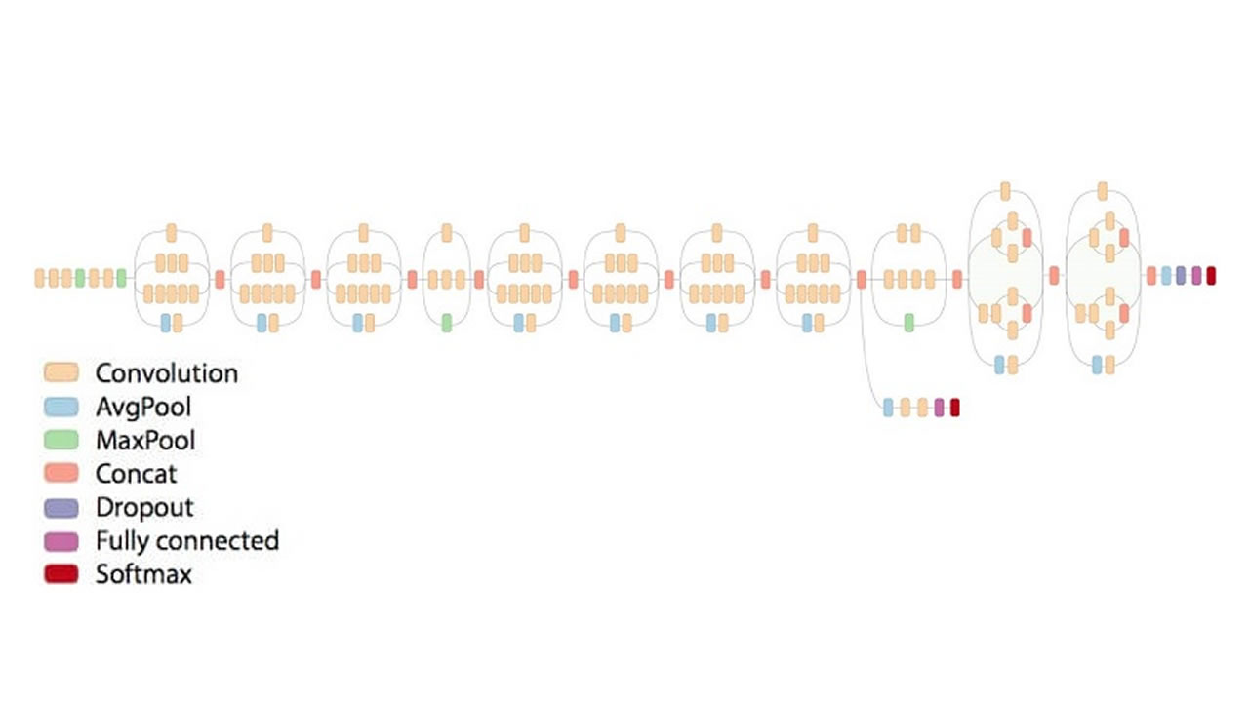
Inception v3

Slide 19
simple model design
Layer name | Specifications
Input layer | Variable size, fits every image
Convolutional layer | 5x5, 16 filters
Max pooling layer | 2x2, stride 2
Global average pooling | Takes averages of filters, changes output to vector with these values
Simple neural network | 3 layers with 50, 100, 50 neurons respectively (reLu activation)
Softmax layer | Sets class predictions

Slide 20
Results (inception v3)
Model | Accuracy
Predicting cardiovascular events (not standardized) | 50%
Predicting cardiovascular events (standardized) | 52,5%
Classifying relative amount of staining (not standardized) | 45%
Classifying relative amount of staining (standardized) | 50%
Classifying amount of staining according to pathologist (not standardized) | 50%
Classifying amount of staining according to pathologist (standardized) | 50%
Classifying symptoms shown by patients (not standardized) | 25%
Classifying symptoms shown by patients (standardized) | 21,5%

Slide 21
New simple model - results
80 percent accuracy on the amount of staining on a plaque as quantified by cellprofiler
Yet to be tested on other datasets after finetuning model to reach higher accuracy scores

Slide 22
Future plans
Finetuning simple network for higher accuracy and application on other datasets
Unsupervised image segmentation

